Slide 1
Analysis of temporal dependencies
We observe that there are no long-term dependencies in the data.
There is no such corelation in data of pollution values over the month over the week
However, we do observe some short-term dependencies where the data follows a particular distribution over the day.
For example, we see a daily dip in pollution at Hour 15

Slide 2
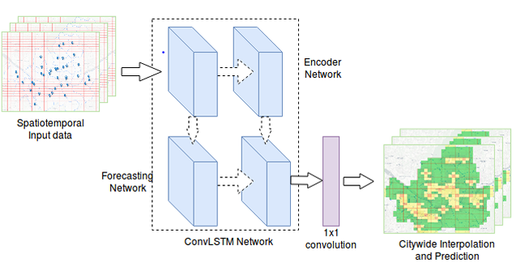
ConvLSTM for data interpolation

Slide 3
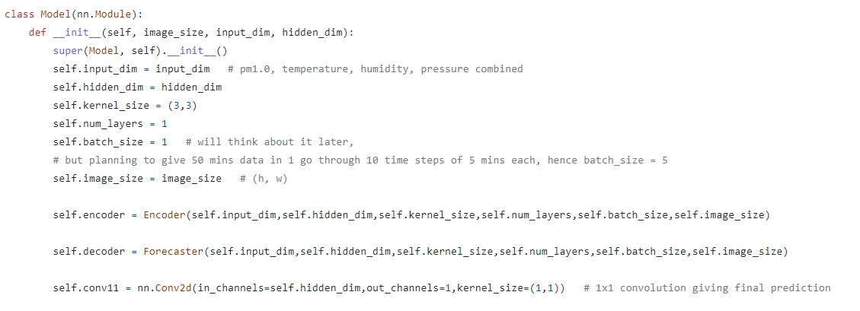
Code for ConvLSTM

Slide 4
Comparing ConvLSTM with GCN
MODEL | Train RMSE _100 | Test RMSE _100 | Train RMSE _full | Test RMSE _full
GPR | 29.76 | 30.41 | 3433.04 | 29.74
Variational GPR | 32.42 | 33.05 | 1053.88 | 30.63
ANN | 47.04 | 47.51 | 141.42 | 32.49
GraphSage | x | 35.45 | 4891.81 | 34.15
GCN | 109.95 | 49.6 | 4.22 | 50.8
ConvLSTM | 51.41 | 181.72 | 2.79 | 30.5

Slide 5
Why ConvLSTM?
It preserves temporal dependencies apart from the spatial ones
GCN only incorporated spatial data
The forecaster in ConvLSTM can interpolate data in the same time slot as well as predict values in the next time slot.
ConvLSTM helps us to explore temporal relations within a day as well as across days

Slide 6
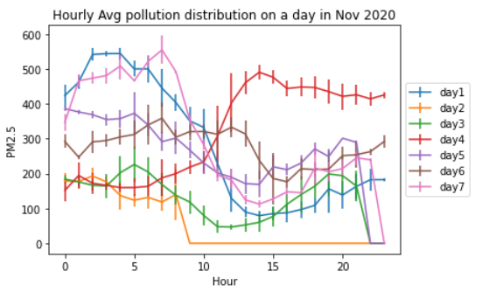
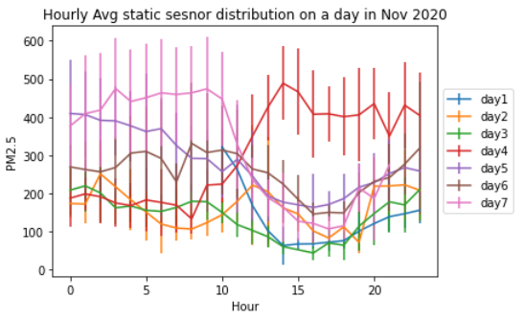
Hourly average pollution values over Nov 2020
Local Buses
Static sensors

Slide 7
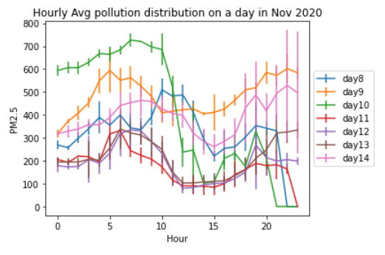
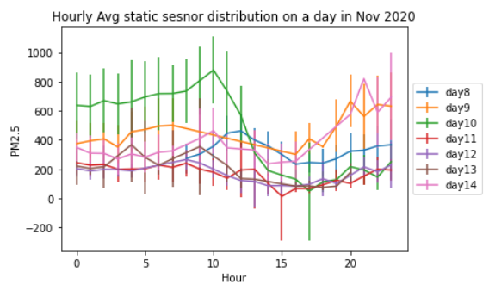
Hourly average pollution values over Nov 2020
Local Buses
Static sensors

Slide 8
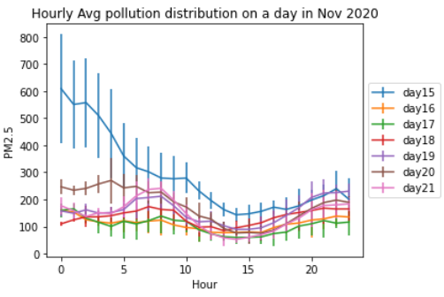
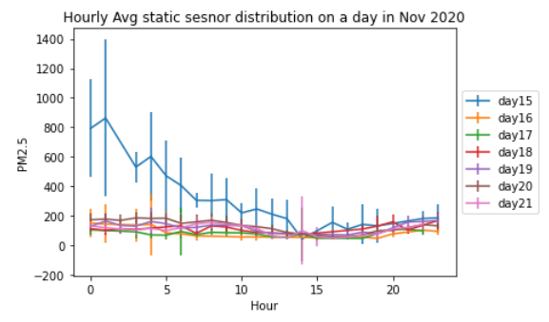
Hourly average pollution values over Nov 2020
Local Buses
Static sensors

Slide 9
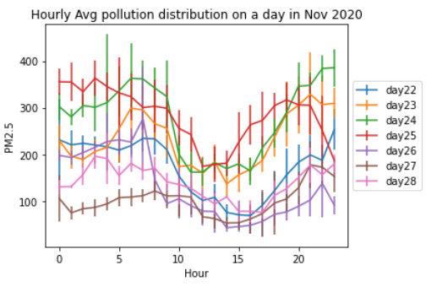
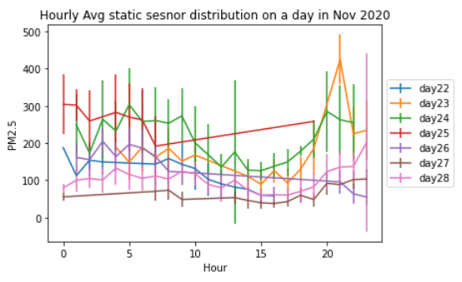
Hourly average pollution values over Nov 2020
Local Buses
Static sensors

Slide 10
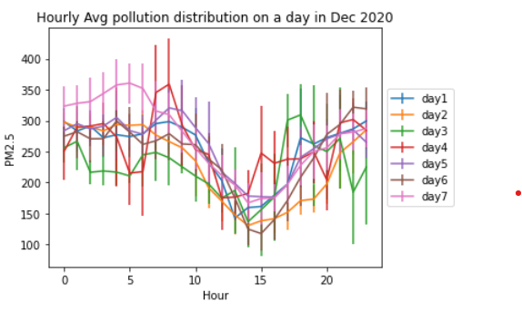
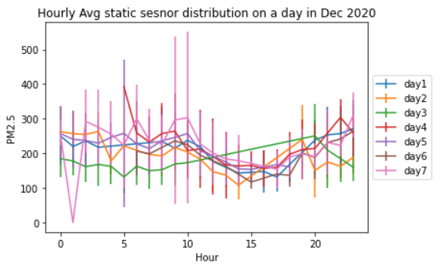
Hourly average pollution values over Dec 2020
Local Buses
Static sensors

Slide 11
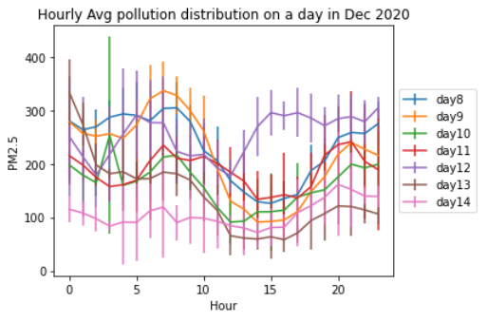
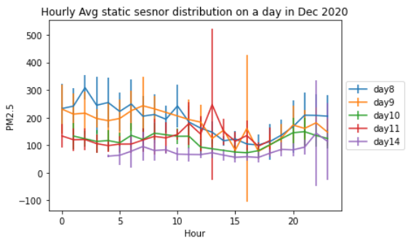
Hourly average pollution values over Dec 2020
Local Buses
Static sensors

Slide 12
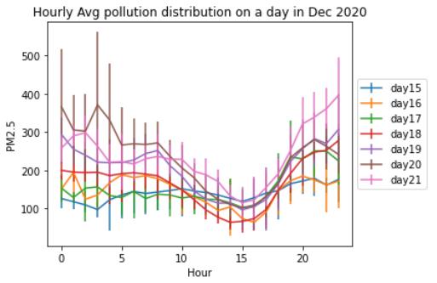
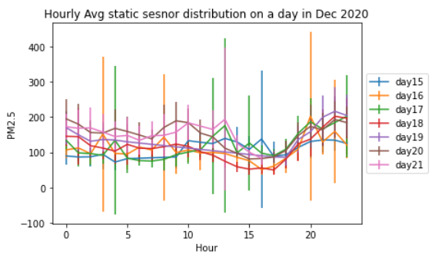
Hourly average pollution values over Dec 2020
Local Buses
Static sensors

Slide 13
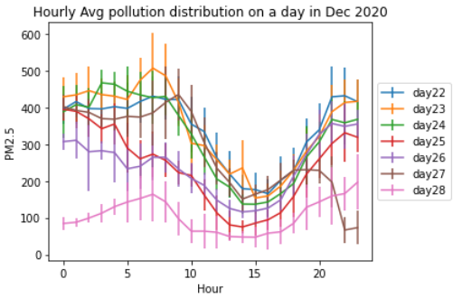
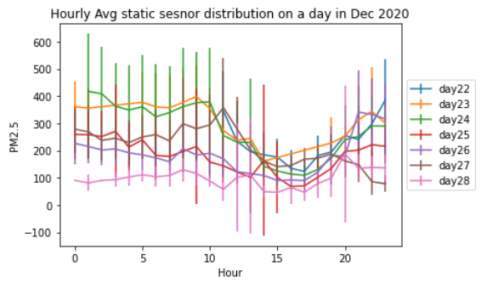
Hourly average pollution values over Dec 2020
Local Buses
Static sensors

Slide 14
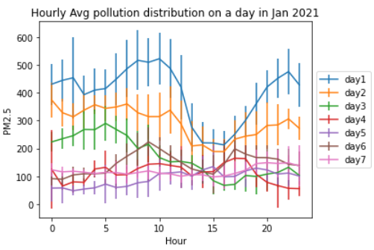
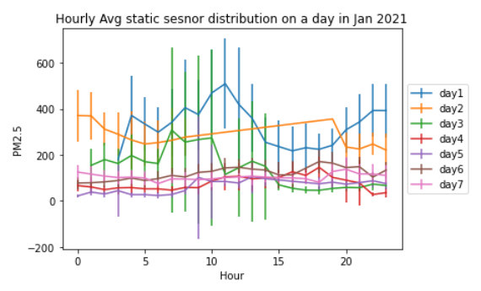
Hourly average pollution values over Jan 2021
Local Buses
Static sensors

Slide 15
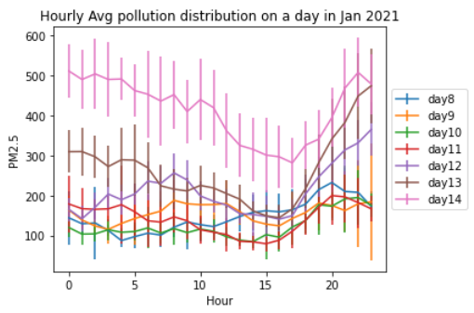
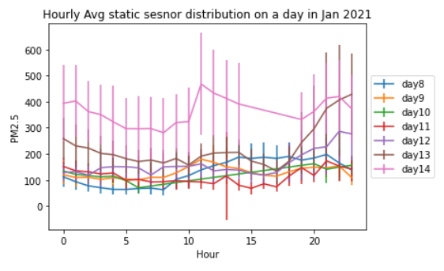
Hourly average pollution values over Jan 2021
Local Buses
Static sensors

Slide 16
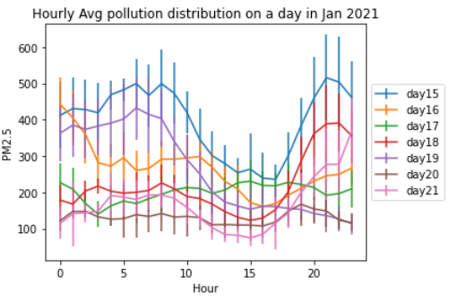
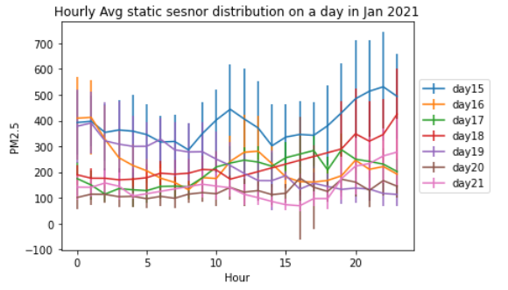
Hourly average pollution values over Jan 2021
Local Buses
Static sensors

Slide 17
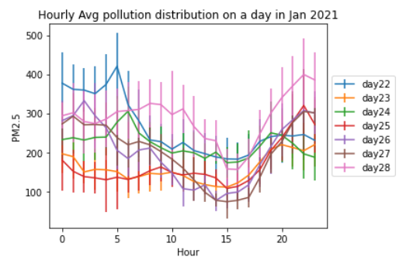
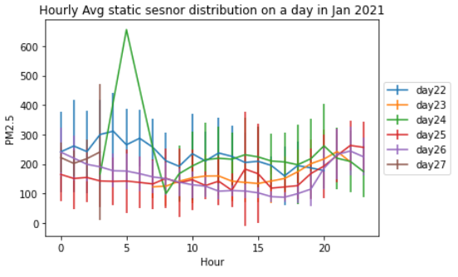
Hourly average pollution values over Jan 2021
Local Buses
Static sensors

Slide 18
Hourly average PM 2.5 Nov 2020
Local Buses
Static sensors

Slide 19
Hourly average PM 2.5 Nov 2020
Bus sensors
Static sensors
Bus sensors
Static sensors

Slide 20
Hourly average PM 2.5 Dec 2020
Bus sensors
Static sensors
Bus sensors
Static sensors

Slide 21
Hourly average PM 2.5 Jan 2021
Bus sensors
Static sensors
Bus sensors
Static sensors

Slide 22
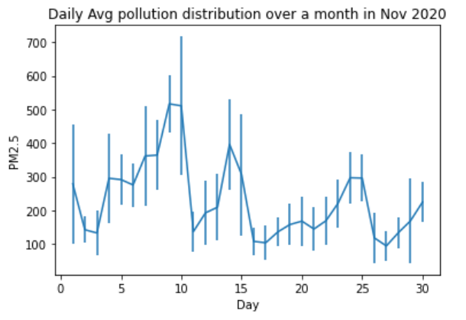
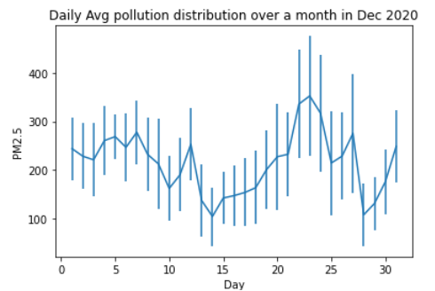
Daily Avg pollution distribution over month

Slide 23
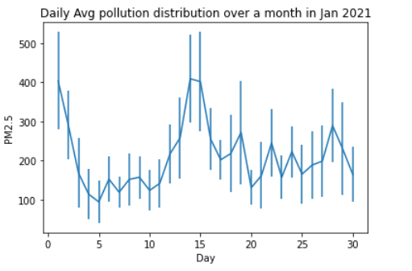
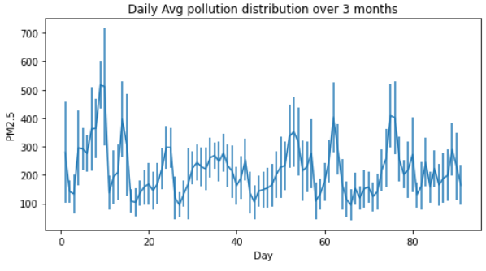
Daily Avg pollution distribution over month

